Slide 1
Predictive model for concrete strength and consistency
Group 28
Zonghai Yang
Taowei Gao

Slide 2
Agenda
1.Data_analysis
2.Random forest
3.Linear (Lasso()) Regressor
4.MLP (Multi-layer perceptron) Regressor
5.DNN (deep neutral network) and Co-Training

Slide 3
Data analysis
Code explanation
Data visualization

Slide 4
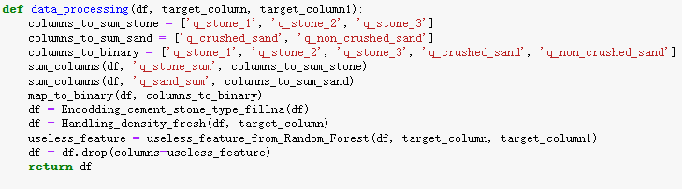
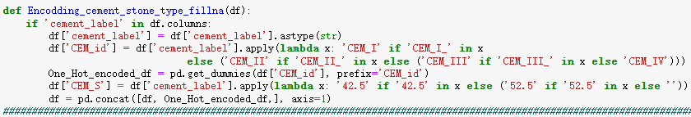
Code explanation
Process
columns_to_drop
columns_to_binary
columns_to_sum
cement_label analysis
Outlier handling
Remove useless_feature
Ideas of data processing
Unsuccessful attempts
Manually exclude variables that won't contribute to regression.
Manually decompose some regression variables to enhance the model's ability to make regression predictions.
Use random forest model to remove useless variables.
Use K-Means method and sns.pairplot function to analyse the relationships between regression variables.
Use scatter plots to visually explore the relationships between regression variables and predictor variables.

Slide 5
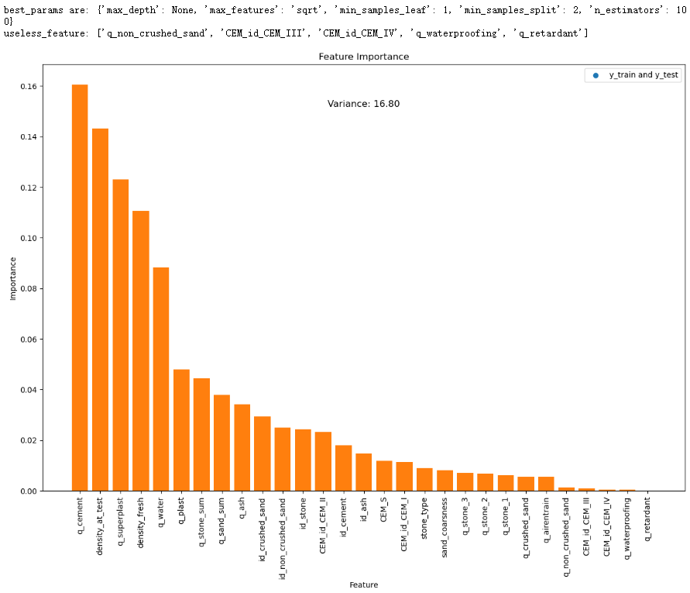
Data visualization

Slide 6
Random forest
Code explanation
Data visualization

Slide 7
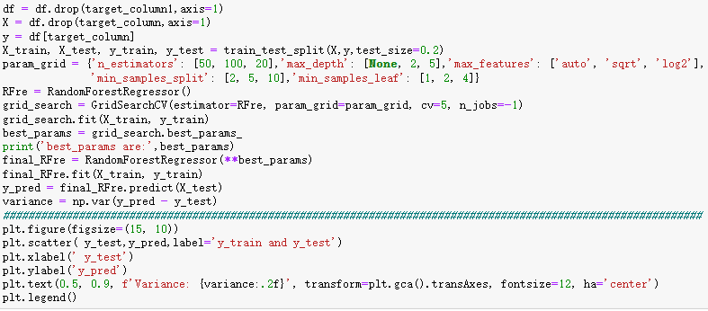
Code explanation
Process
Data analysis
Hyperparameter selection.
Visualizing results and calculating variance.

Slide 8
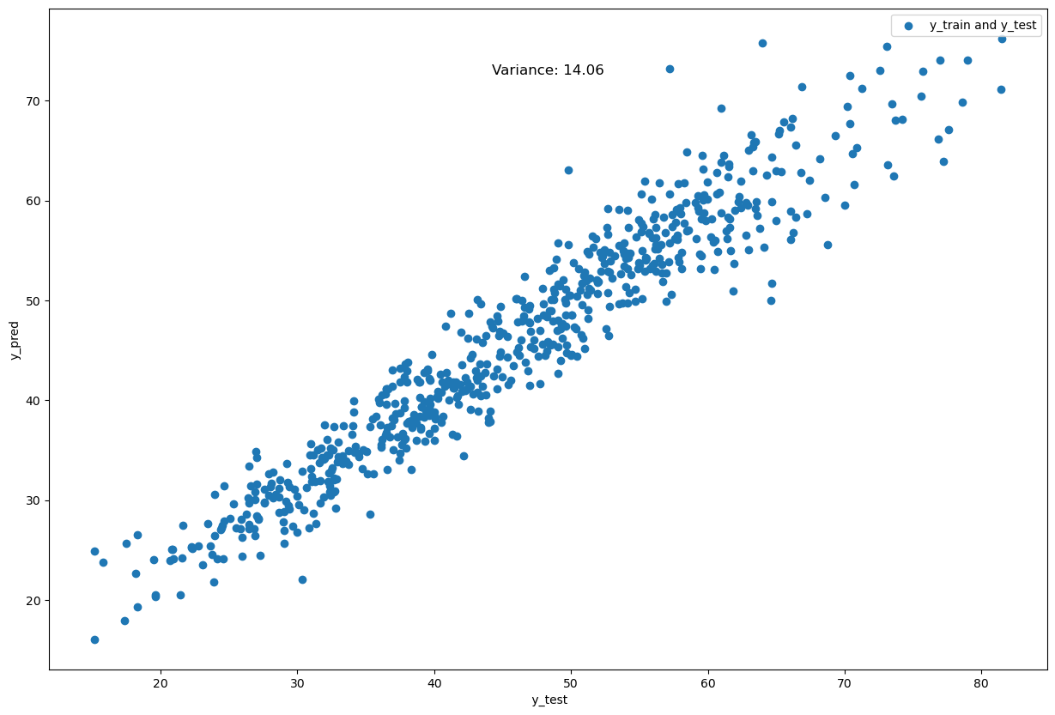
Data visualization

Slide 9
Linear(Lasso())-Regression
Code explanation
Data visualization

Slide 10
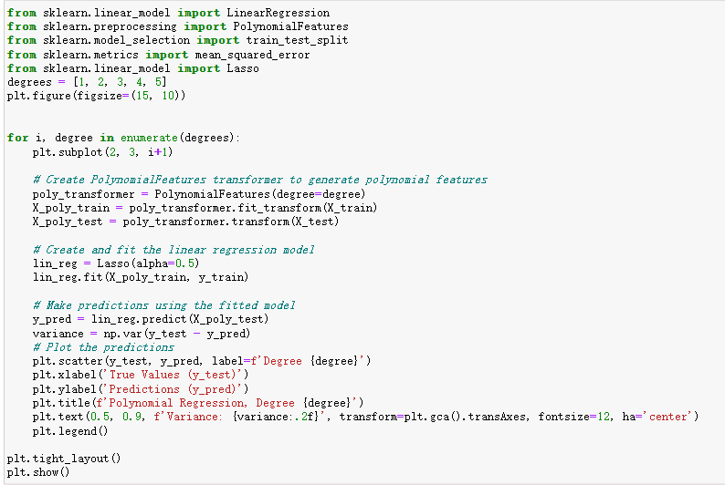
Finding the optimize degrees of polynomial
Using 1 to 5 degrees
Transferring polynomial features to generate
Using linear regression model
Calculating the variance
Plotting the graphs

Slide 11
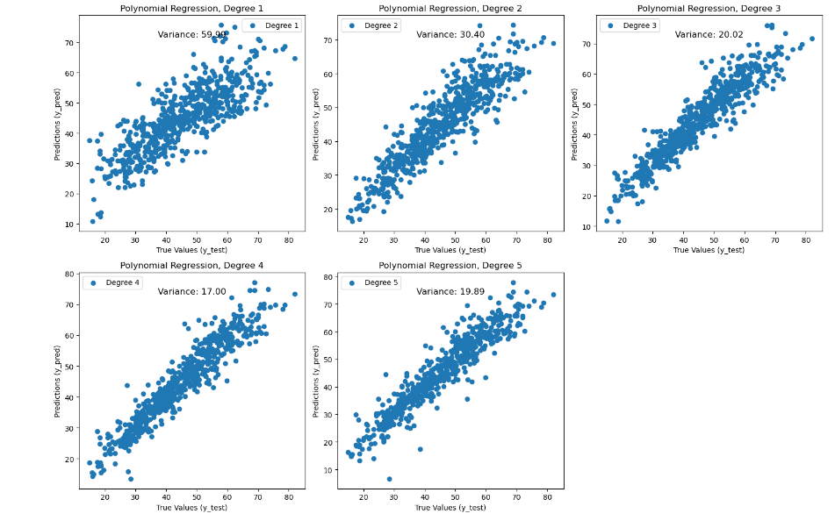
Result of the optimize degrees of polynomial
minimum deviation found in degree 4

Slide 12
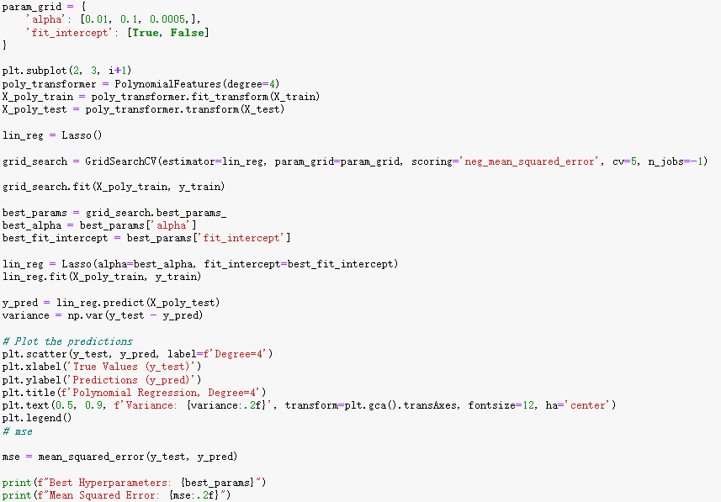
Using grid Search Method
Choosing hyperparameter
Transferring polynomial features to generate
Add regularization term
Using gird search method to fit data calculating 3*2 times
Using the optimal hyperparameter predicting the data again
Calculate variance
Plotting graphs

Slide 13
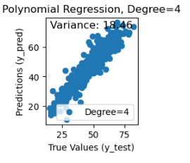
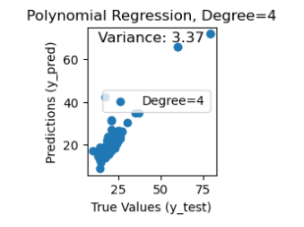
Result of linear regression
For predicting concrete strength, the optimal hyperparameter is True, 0.0005 with 4 degrees and the squared Error is 18.48.
For predicting slumps, the optimal hyperparameter is False, 0.0005 with 4 degrees and the squared Error is 3.37.
Concrete strength
slump

Slide 14
MLP (multi-layer perceptron) Regressor
Code explanation
Data visualization

Slide 15
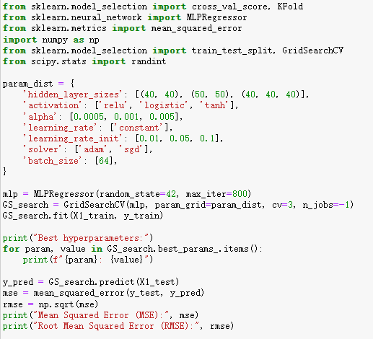
Finding the optimal hyperparameter
The choice of hyperparameters
Calculating 3*3*3*1*3*2 times
Setting fixed random number and maximum iteration for each calculations
Output the best hyperparameters

Slide 16
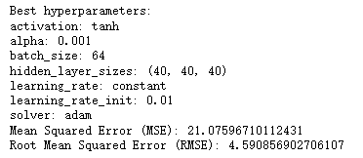
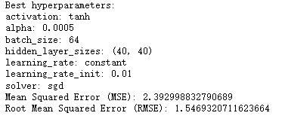
Result of MLP Regressor
For concrete strength
For slump

Slide 17
DNN and Co-Training
Code explanation
Data visualization

Slide 18
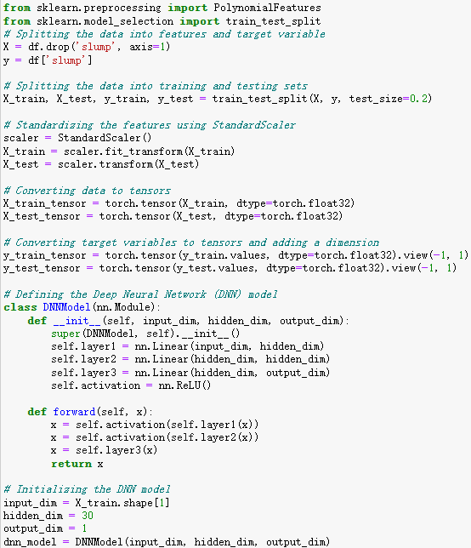
Code explanation
Process
Data analysis
DNNModel
Joint training
Visualizing results and calculating variance.

Slide 19
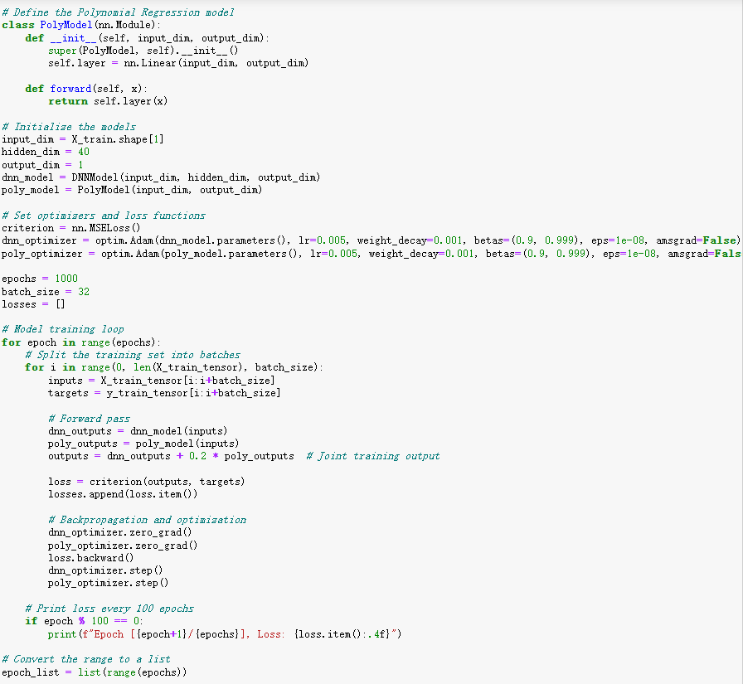
Code explanation
Process
Data analysis
DNNModel
Joint training
Visualizing results and calculating variance.

Slide 20
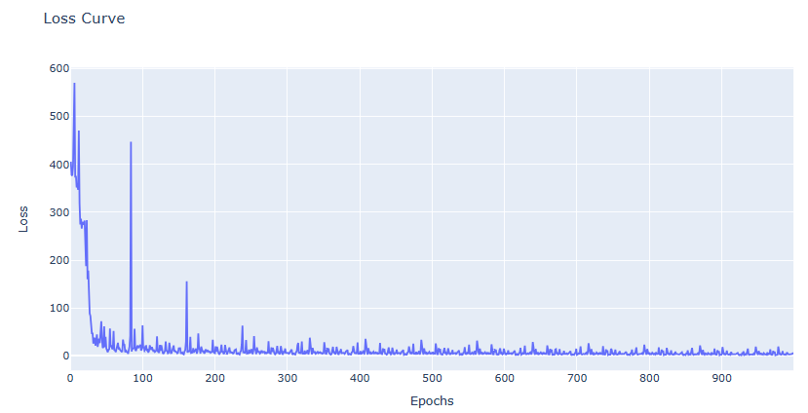
Data visualization

Slide 21
Thanks for your attention!

